Slide 1
AI Travel Planning agent
IBM AICTE PROJECT
Presented By:Rasineni Varshini
Student name :Rasineni Varshini
College Name & Department : madanapalle institute of technology & science(demmed university) & computer science & Technology

Slide 2
OUTLINE
Problem Statement
Technology used
Wow factor
End users
Result
Conclusion
Git-hub Link
Future scope
IBM Certifications

Slide 3
Problem Statement
The Challenge –
A Travel Planner Agent is an AI-powered assistant that helps users plan trips efficiently and intelligently. It uses real-time data to suggest destinations, build itineraries, and recommend transport and accommodation options . By understanding user preferences, budgets, and constraints, it tailors personalized travel plans. Integrated with maps, weather updates, and local guides, it ensures a smooth travel experience . The agent can also manage bookings, alert users to changes, and optimize schedules on the go . This smart assistant transforms complex travel planning into a seamless, enjoyable process
Proposed solution-
The proposed solution is to develop an AI-powered virtual assistant using IBM Watsonx that helps users with travel-related queries. This assistant can suggest the best hotels, popular destinations, and basic travel information based on user input.

Slide 4
Technology used
IBM cloud lite services
Natural Language Processing (NLP)
Retrieval Augmented Generation (RAG)
IBM Granite model

Slide 5
IBM cloud services used
IBM Cloud Watsonx AI Studio
IBM Cloud Watsonx AI runtime
IBM Cloud Agent Lab
IBM Granite foundation model

Slide 6
Wow factors
Instant Itinerary Magic
Just type your dream destination and preferences, and the AI builds a full itinerary in seconds.
Includes flights, hotels, local experiences—even quirky food spots you’d never find on your own.
Multi-Agent Coordination
Behind the scenes, multiple AI agents collaborate to build your perfect trip.
You can even watch them work in a live dialog box—like a digital travel war room.
Automated Day-by-Day Itineraries
You enter your destination, number of days, and preferences.
The AI instantly generates a detailed schedule for each day: morning, afternoon, evening.

Slide 7
End users
Individual Travelers
Travel Industry Professionals
Travel Industry Professionals
Developers and Researchers
Government and Tourism Boards

Slide 8
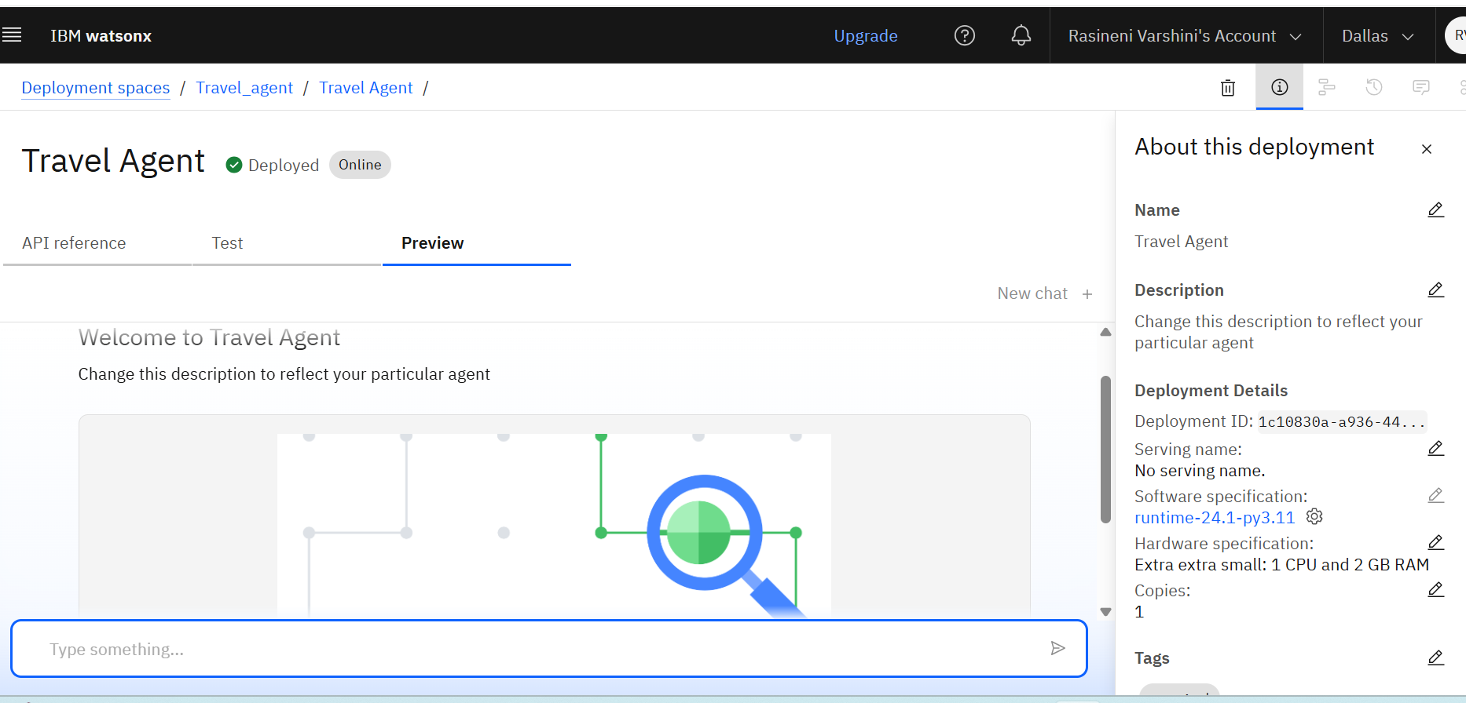
Results
The Travel Agent is a virtual assistant project created and deployed on the IBM Wat sonx platform. It is designed to handle travel-related queries such as booking tickets, suggesting travel destinations, and assisting users with travel plans. The assistant is currently in an active state — deployed and online, which means it is ready for interaction either through the test interface or integration via APIs.

Slide 9
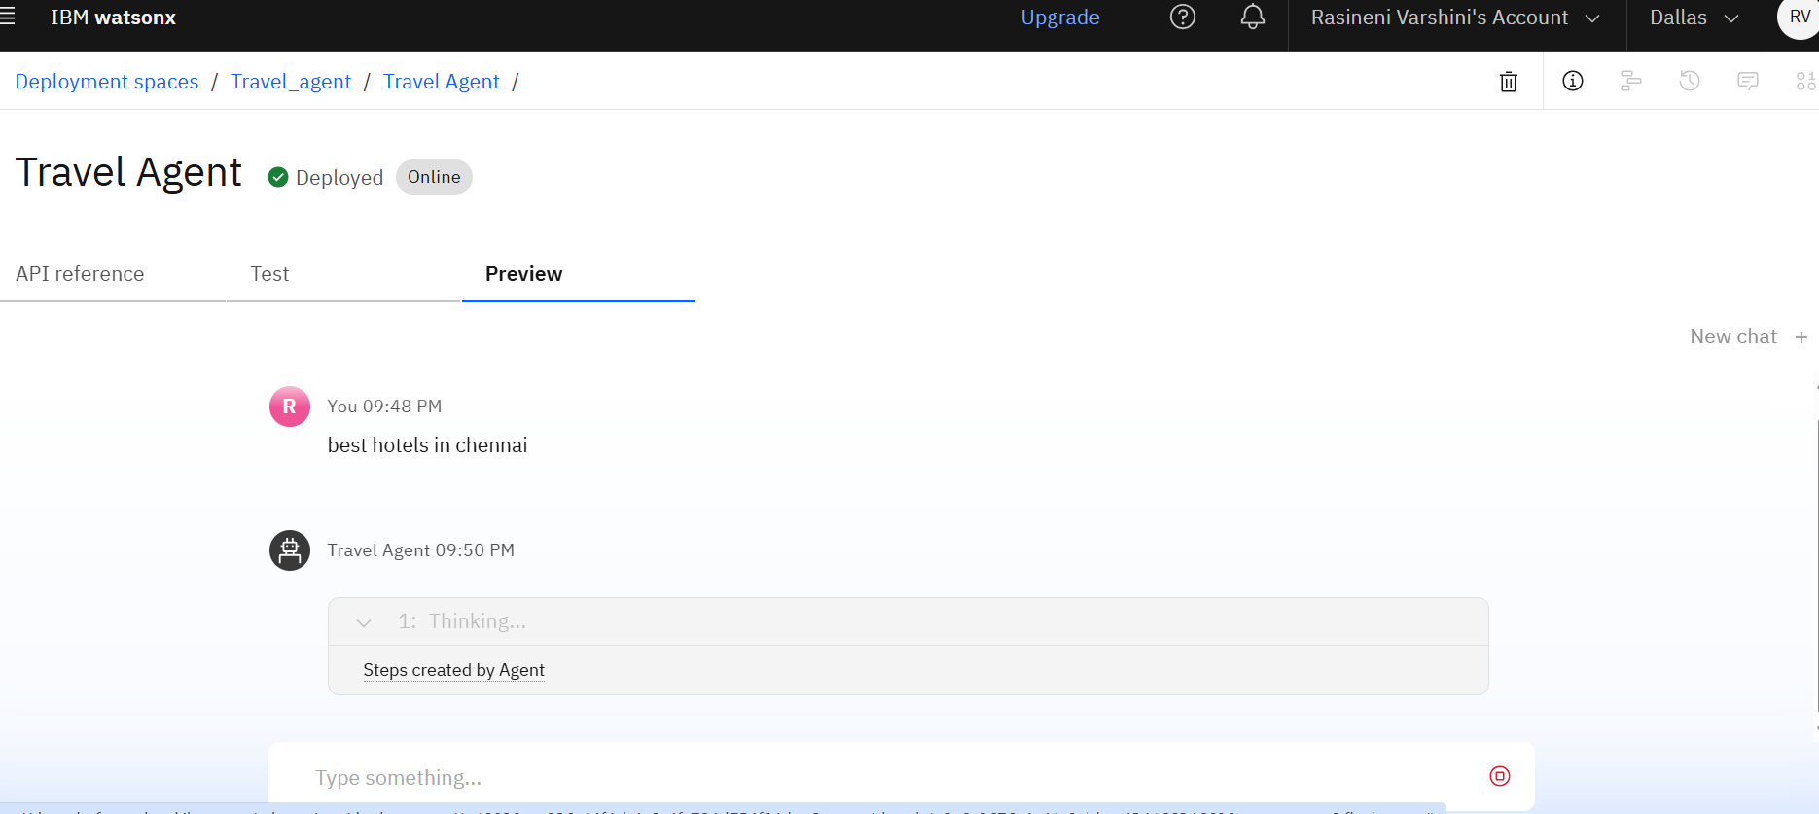
Results
This response suggests that the assistant has been configured to recognize travel-related intents (like finding hotels) and is capable of executing a defined response or a set of steps related to the user's input. While the reply in the screenshot is generic, it shows that the assistant is functioning and mapping user queries to predefined agent flows.

Slide 10
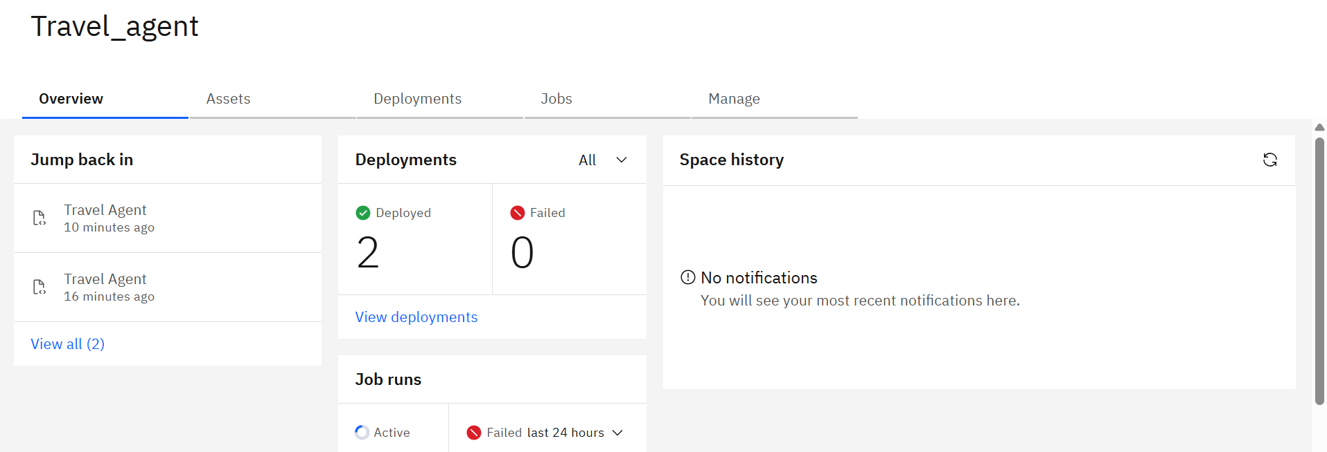
Results

Slide 11
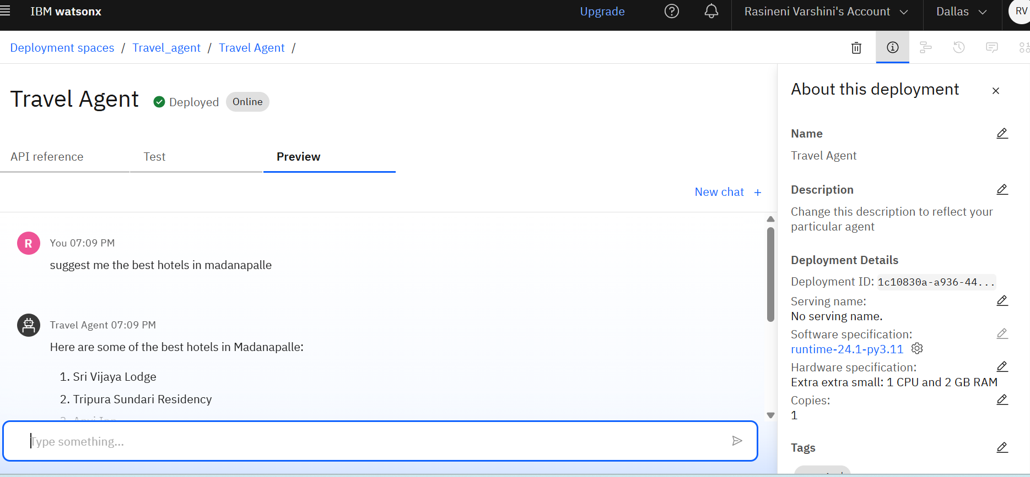
Results deployed Ai agent
Functionality :The assistant is able to understand natural language .
Queries . It provides relevant and location-specific travel suggestions

Slide 12
Conclusion
The Travel Agent assistant gives hotel suggestions based on user queries.
It works well and can be used in travel-related problems and gives best solutions.
It saves time by automating booking the flights in relevant locations and about the stays.ement

Slide 13
Future scope
Add live hotel booking feature.
Suggest flights and travel packages.
Support multiple languages
Use voice input for easier access.
Show maps and nearby places.

Slide 14
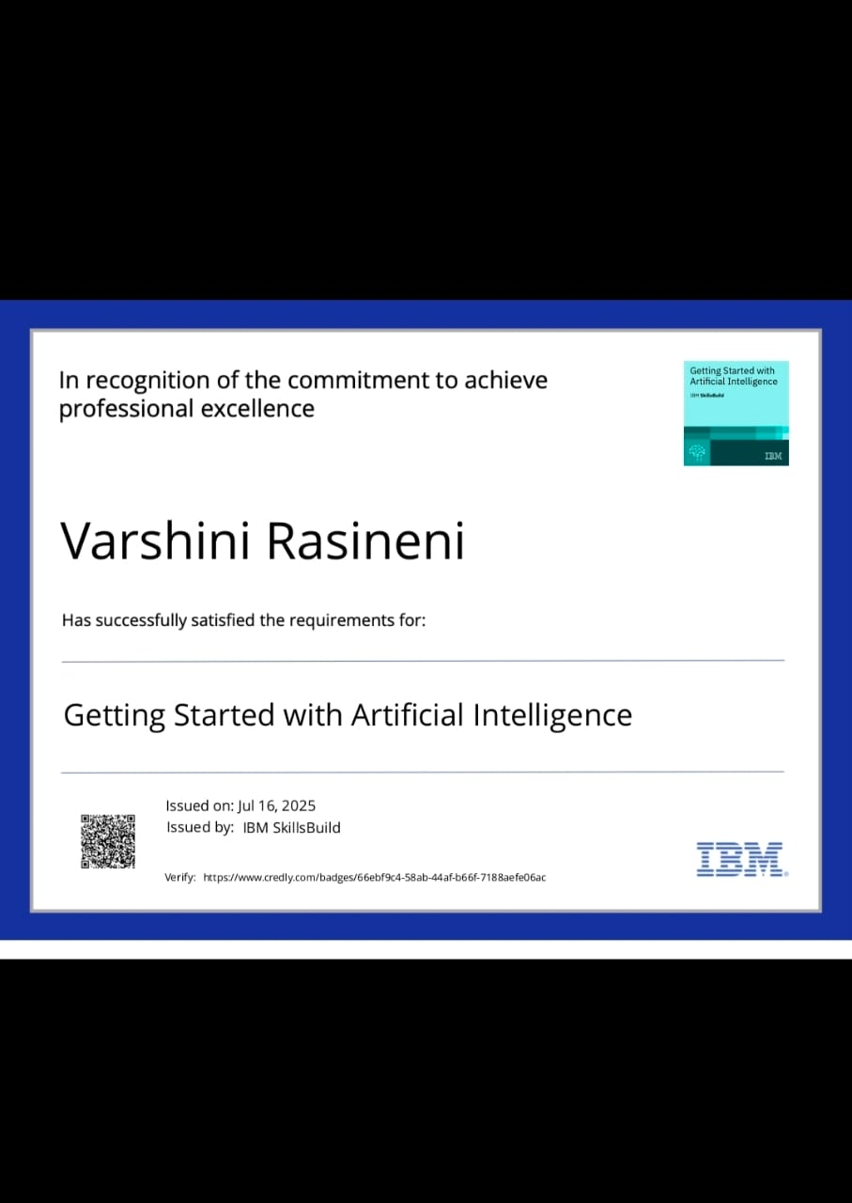
IBM Certifications

Slide 15
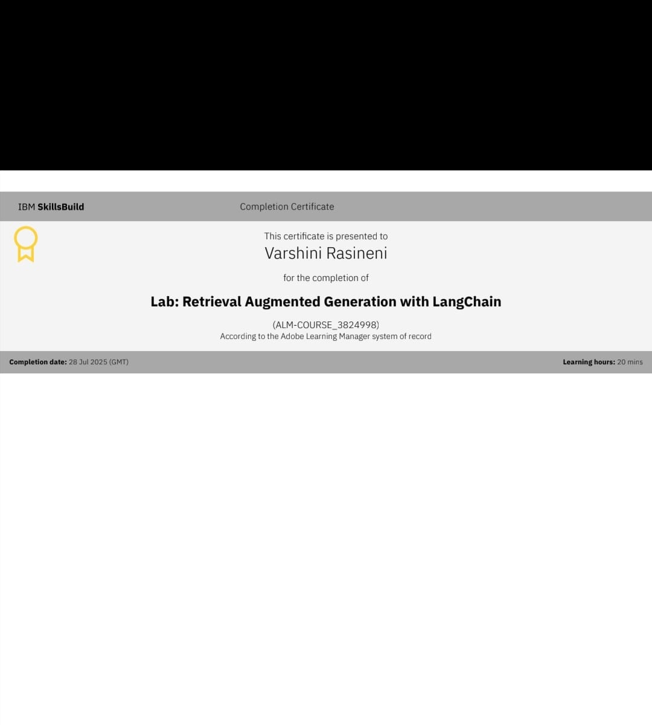

Slide 16
GiT HUB LINK:
Git hub link :

Slide 17
Thank you -rasineni varshini

